Slide 1
SRCNN
Super Resolution using Deep CNNs Image Patch Upsampling
CNN
Rithvika Pervala
Shubham Gupta
Notes:
This is team SPECTRUM and we will be presenting on the topic of Image Patch Upsampling in SRCNNs.

Slide 2
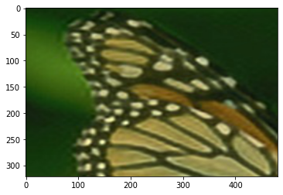
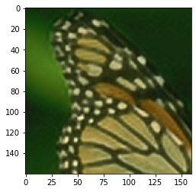
Introduction
Upsampling
Adaptation to a situation where the image scale is larger than the current scale by using an estimation model.
Description
DSP - Digital Signal Processing
Zero Stuffing
Applications/Use cases
Visual Appeal
UHD Images
Notes:
Upsampling is defined as expansion of an image resolution to a scale which is bigger than it’s current scale. It is an estimation model that approximates the current image pixels and resizes and fills up the unknown pixels.
Description
Upsampling was first introduced in the concept of digital signals processing after which it was extended to the image processing domain.
It does zero stuffing of signals onto the main sample (original image) when it resizes - we get blank/missing spaces or zero spaces that needs to get estimated as the resolution increases
Applications
In digital photography, upsampling is generally used in post processing phase to increase the resolution of images.
Visual Appeal Factors - Image Smoothening, Reduced Pixelation, Noise Elimination, Image Consistency can be increased
UHD - In the pixels of extremely high resolution images such as UHD images to make them indistinctive during the pixel classification process.

Slide 3
Objectives
See the impact of upsampling certain regions in High-Resolution Images
Post-process the output images by extracting certain regions and apply upsampling techniques on them.
Prepare a comprehensive analysis using multiple image similarity metrics and contrast between the upsampled and input images
Notes:
Upsample certain regions in High-Resolution Images and see the impact of upsampling in the quest of clearer High-Resolution Images.
Post-process images after the output of the SRCNN model by extracting certain regions and apply upsampling techniques on them.
Use multiple image similarity metrics and prepare a comprehensive analysis on how each similarity metric contrasts the upsampled and input images

Slide 4
Methodology
UPSAMPLING TECHNIQUES AVAILABLE
UPSAMPLING TECHNIQUE CHOSEN
IMPLEMENTATION PROCEDURE
EVALUATION
Notes:
Now we will move onto the methodology of the project

Slide 5
Available Upsampling Techniques
Behaviour Methodology
Adaptive
Vary the upsampling based on the assigned input
Adaptation of the Local structure/Directional
Proprietary - Adobe Photoshop and Photozoom Pro
Non Adaptive
Equal pixel treatment
Examples: Nearest Neighbour, Bilinear, Bicubic
Modified Adaptive
Enhancement of current Adaptive techniques
Fully customizable to suit a particular set of data
Edge Guided Image Interpolation - Research Domain
Notes:
We classify and contrast the upsampling techniques based on the their behaviour to the assigned input images
Adaptive
These algorithms vary the upsampling technique based on the assignment. Adaptive algorithm use image features to improve the interpolation result. They work based on different intensity present and local structure of image. Generally used to enhance edges by using local gradient. They also use directional interpolation to deblur and remove blocking artifacts. They are used in many proprietary applications such as Adobe Photoshop and Photozoom Pro which are commonly used for photo and video editing purposes.
Non Adaptive
These methods treat all the pixels in the image equally and do not follow the principle of in-pixel contrast to upsample images. They use the data from each pixel equally to upsample the images. Some of the popular examples include
Nearest Neighbour - This technique uses nearest neighbor's pixel to fill interpolated point.
Bilinear - The interpolated point is filled with four closest pixel’s weighted average. In this method we performed two linear interpolations, in horizontal direction and then linear interpolation in vertical direction. We need to calculate four interpolation function for grid point in Bilinear Interpolation.
Bicubic - In this method, interpolated point is filled with sixteen closest pixel’s weighted average. We can get sharper image than bilinear method. We get the best results among all the modern non-adaptive techniques using this method
Modified
They are an enhancement of the current Adaptive techniques which are fully customizable to suit a particular set of data. They are built on top of the adaptive algorithms
for better performance. One famous example which is still under development is the Edge Guided Image Interpolation.
The edge guided image interpolation technique partitions pixels into two directional and orthogonal subsets. Directional interpolation is made for each Subset and two interpolated values are fused. This algorithm works for gray scale images only. The extension of this technique to RGB images is still under development with extensive research going on.
It is a popular field of research.

Slide 6
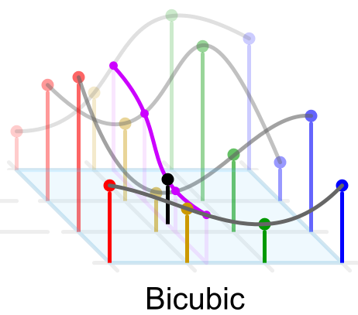
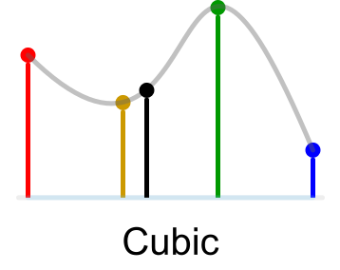
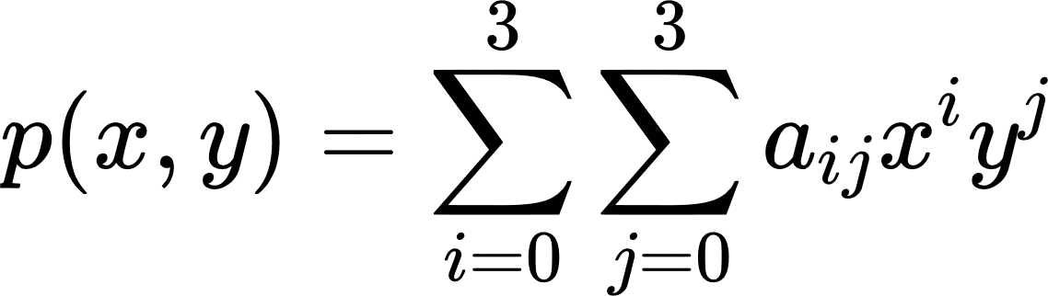
Chosen Upsampling Technique - Bicubic
Notes:
to construct a cubic curve (spline) in one dimension - the coefficients of the curve - Takes in four factors
the 2 Original Pixels to construct the intermediate missing pixels from
The Gradient at these two Pixels - This gradient is calculated from the outer original pixels surrounding the above ones
Does Cubic Interpolation on one dimension and Extends it to the 2nd dimension of the image and then finds the missing values
This can help do complex shapes
Formula
The interpolation problem consists of determining the 16 coefficients a i j with the function values yields four equations:
Bicubic considers the weighted average of the 16 nearest neighbors, if you see the image here it shows a 4 * 4 matrix (16 points are covered)

Slide 7
Implementation Procedure
Split into 3 major parts:
Reverse Pre-Processing/Deprocessing
Upsampling
Evaluation
Notes:
The implementation of bicubic upsampling is done into 3 parts:
Deprocessing is the phase where we essentially obtain the SRCNN images to upsample
Upsampling - The phase where we actually perform the upsampling after the iterative crop
Evaluation - The phase where we use multiple image metrics to contrast between images

Slide 8
Deprocessing
Obtain the current model state
Un-Standardization
Un-Normalization
Colour Space Integration
YCbCr -> RGB colour spacing
Integrate 3 dimension to a single dimension
Contrast of Images
Classification of Output
Iterative Deblurring
Standard Mean: 0.43398995682829317
Standard Deviation: 0.23199219136380714
Notes:
As we need to obtain the deblurring at each point we save the torch state at each epoch and obtain the SRCNN images. This is done by using following steps
Un-Standardization
The reverse process of standardization is done i.e. we multiply the standard deviation followed by addition of the standard mean. As the dataset remains the same, the values remain the same. They are as given below
Un-Normalization
We divided the image colour space into the regular size of 256 for model processing in the previous part. The reverse is done here where integrate the entire size of the colour space to form one ground truth image.
Colour space Integration
As the colour space was split during the pre-training, we link all aspects of the Ycbcr colour space for the image to be ready. As the image was split into 3 dimensions we bring all the dimensions together into a single one. As there is an initial conversion from RGB to YCbCr, we need to do the reverse i.e. YCbCr to RGB.
Classification of output
We then classify the outputs based by processing the images on upsampling with the SRCNN till the training epoch.

Slide 9
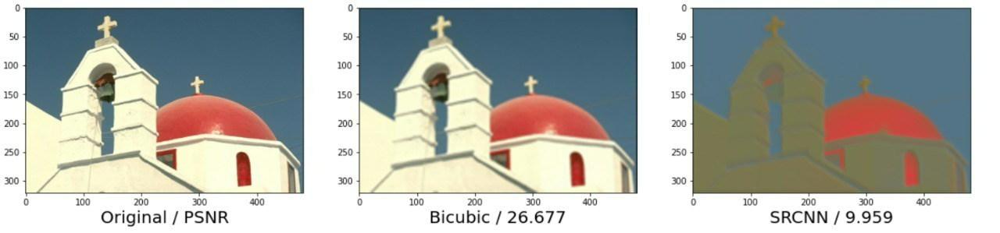
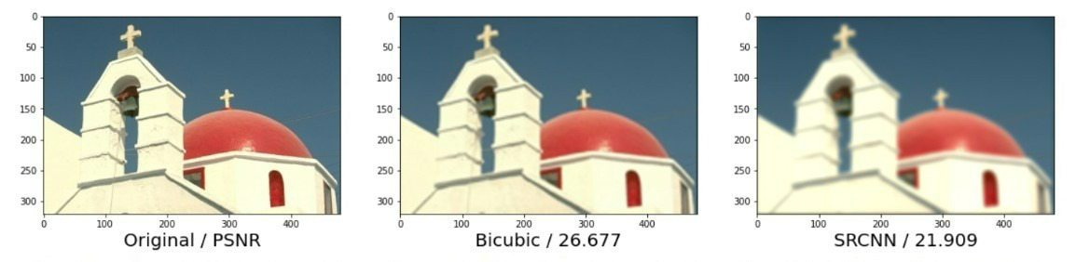
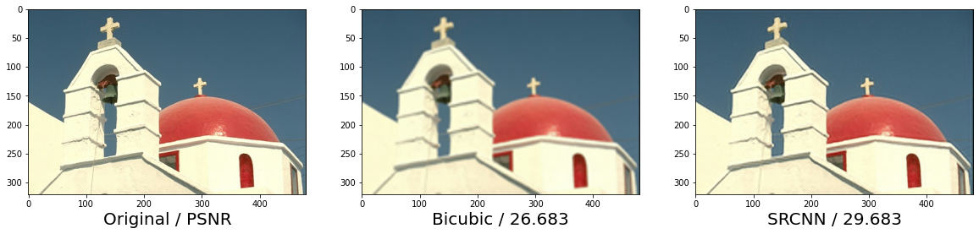
Deprocessed Image Contrast
Notes:
We will now see the contrast of the deblurred images after each epoch.
We execute the processing on each epoch of the model and save the images in a directory to apply upsampling techniques on them.
We can also plot these integrated images and see the progress of the SRCNN model over different epochs.

Slide 10
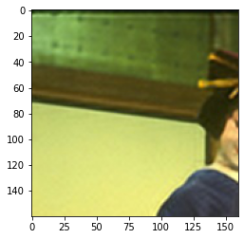
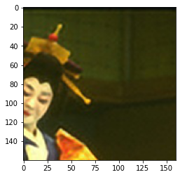
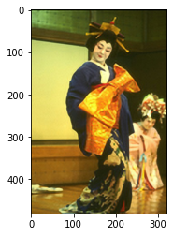
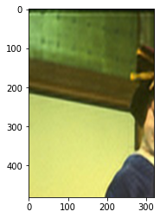
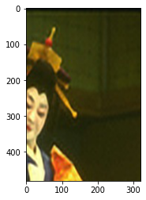
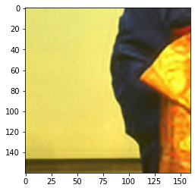
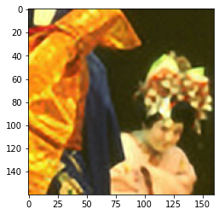
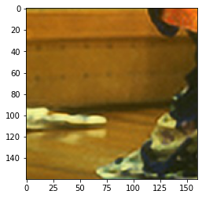
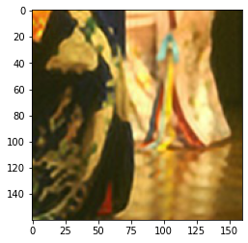
Upsampling
Notes:
Definition
In images, upsampling deals with the increasing the spatial resolution of while keeping the dimensions same. The colour coding and matrices are retained, with resolution enhanced.
In the process of upsampling, dimensions are increased that leads to a lot of pixels staying empty. Upsampling fills these empty pixels, a term known as Zero-stuffing in digital photography, with approximate and estimated data based on the input image.
Iterative Cropping
In our case we take the output images generated from the SRCNN Model after 9000 epochs and iteratively crop the images using a custom function get_image_crops() from the Postprocessing Folder.
get_image_crops() gets the crops by iteratively striding over the submatrices of given height and width (default 160 pixels each) and then returning these crops.
Since the Output images are either 480 x 320 or 320 x 480, we will get a total of 6 crops per image with the default crop height and width (160)
Bicubic Interpolation Upsampling
We then use these Cropped Patches and upsample them using bicubic interpolation. We do that by using another custom function upsample_images() from the Postprocessing Folder.
Other upsampling techniques like Bilinear Interpolation can also be implemented, but we chose to go with Bicubic

Slide 11
Evaluation
Multiple Image Similarity Metrics
Varied Geometries
Euclidean
Analytical
Differential
Parallel Aspects
Metrics
PSNR | SSIM
RMSE | SRE
SAM | COS
UIQ ISSM FSIM
Notes:
We incorporate multiple metrics using different geometries such as Euclidean, Analytical, Differential, etc as it helps to understand all aspects and features of the image and its subsections to give a better and more accurate and comprehensive analysis.
These metrics essentially quantify the degree of visual and semantic similarity of a pair of images. In other words, they compare two images and return a value that tells you how visually similar they are. It is done in 2 phases, feature extraction to describe the image content. These features can be extracted from the whole image or a particular section. This is followed by application of a suitable metric to assess the similarity of two images based on the feature space.
Moving onto the evaluation metrics used to compare between the images before and after the upsampling phase, we use 6 metrics to compare between the images. They are PSNR, SSIM, RMSE, SRE, SAM, COS, Other evaluation metrics are
UIQ, ISSM and FSIM.

Slide 12
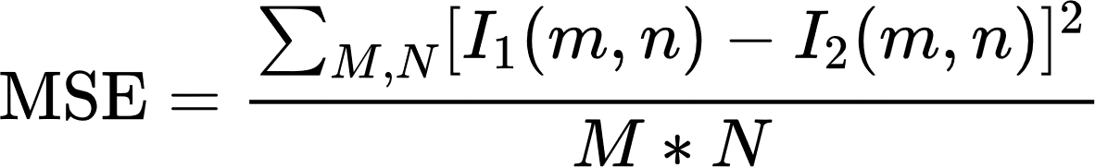
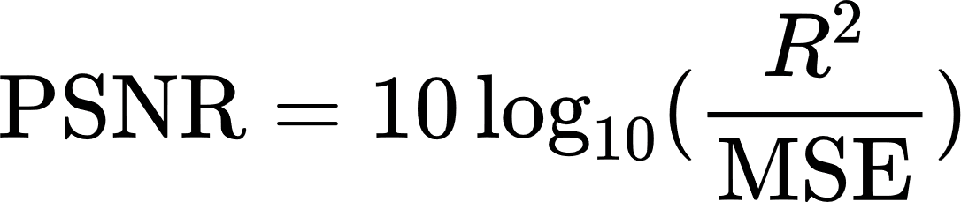
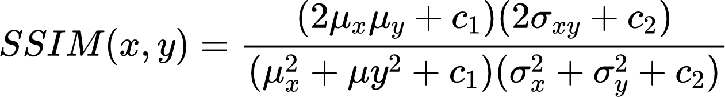
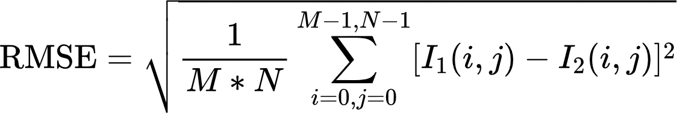
Evaluation Metrics
PSNR - Peak Signal to Noise Ratio (Computed using MSE)
Decibel (dB) scale expressed on the logarithmic scale
SSIM - Structural Similarity Index Measure
RMSE - Root Mean Square Error
Notes:
We have shown the mathematical formulation of all the considered metrics. I will be giving a brief outlook on all of them.
PSNR Peak Signal to Noise Ratio measures the ratio between the maximum possible power of a signal and the power of corrupting noise that affects the fidelity of its representation. It is expressed on the decibel scale.
Where R - Maximum possible pixel value, I1 is the Original Image, I2 is the Predicted Image, M - Number of Rows and N - Number of Columns
SSIM Structural Similarity Index Measure
The SSIM metric quantifies image perception to the human eye. It ranges between [-1, 1].
It is evaluated using the following equation
Where, ux is Average of x, uy is Average of x, sigma x is variance of x, sigma y is variance of y, sigma xy is covariance of x and y, c1 and c2 are constants and L is the Dynamic Range of Pixel Values.
RMSE Root Mean Square Error
This metric measures the amount of change per pixel due to the processing and ranges from [0, 1].
with 0 meaning being the images being compared are identical. It is calculated using the following equation
Where, I1 is the Original Image, I2 is the Predicted Image, M - Number of Rows and N - Number of Columns

Slide 13
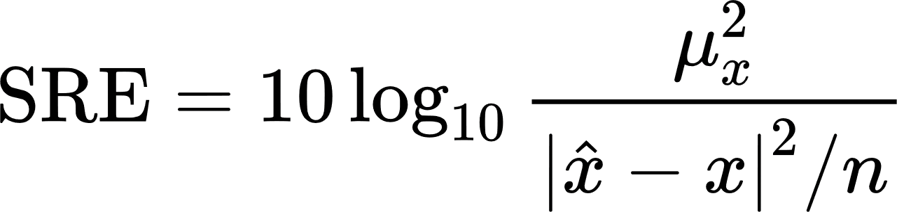
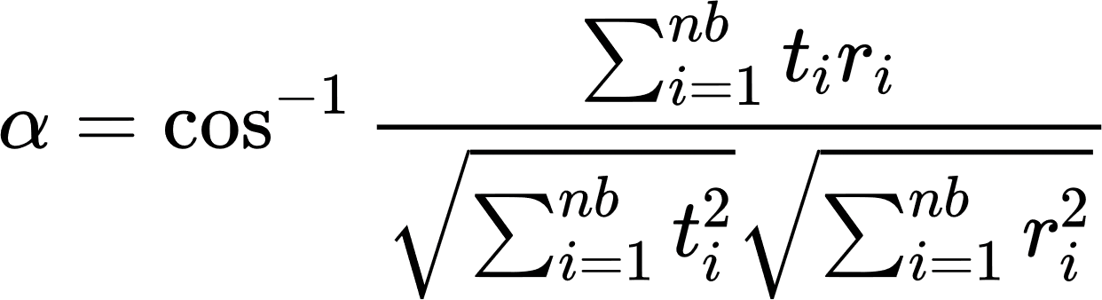
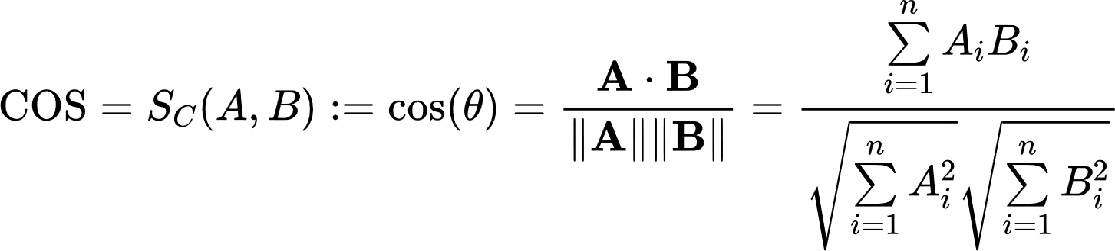
More Evaluation Metrics
SRE - Signal to Reconstruction Error Ratio
Uses the Decibel Scale (Incorporated Logarithmic Factor)
SAM - Spectral Angle Mapper
COS - Cosine Similarity
Notes:
SRE Signal to Reconstruction Error Ratio measures the error relative to the power of the signal. It is best suited for comparing images of varying brightness even when the peak intensity is constant. As upsampling Is considered, the brightness of the image is bound to change making it a very important metric to consider. It uses the decibel scale for computing the ratio similar to PSNR.
THis is the equation used where “Ux” is the average of x.
SAM Spectral Angle Mapper is a physical based spectral classifier that determines the spectral similarity between two spectra by calculating the angle between the spectra and treating them as vectors in a space with dimensionality equal to the number of bands.
It is determined by the following equation where t,r is Image Pixel Spectrum, n is the Number of available spectral bands and b is the bandwidth
COS Cosine Similarity is a trigonometric measure that Quantifies the image similarity in terms of pose angle. It is essential the Euclidean Dot Product of the two images and ranges between [-1, 1]
which is the standard range of the cosine function. It can be calculated using the below equation for two images A and B. As the cosine function compute the similarity between two vectors, A and B represent the vector space of the input image parameters.

Slide 14
Other Evaluation Metrics
UIQ - Universal Image Quality Index
ISSM - Information theoretic-based Statistic Similarity Measure
FSIM - Feature Similarity Indexing Method
Excess memory
4000+ comparisons
Notes:
Moving onto few other metrics such as UIQ: Universal Image Quality index. ISSM: Information theoretic-based Statistic Similarity Measure.
FSIM: Feature Similarity Indexing Method. A single iteration of running these metrics on a couple of images caused the RAM to exceed and a session crash.
These metrics caused a session crash for a single comparison making them an unviable option to be incorporated in our analysis. It will take too long to run them for over 4000+ comparisons leading to memory and time issues.

Slide 15

Results
EVALUATION METRICS
Notes:
Moving onto the results of the model

Slide 16
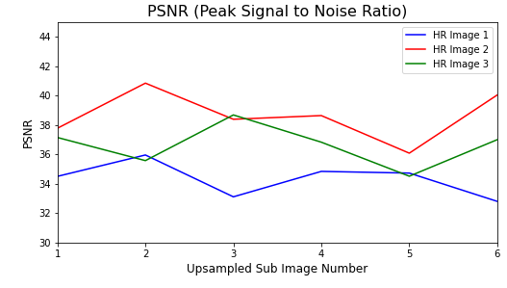
Q & Session
Evaluation Metric - PSNR

Slide 17
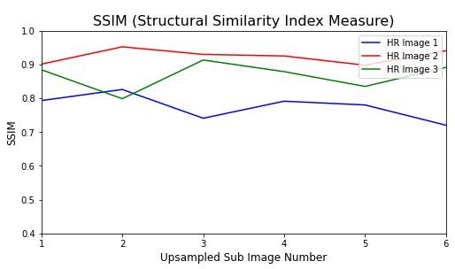
Q & Session
Evaluation Metric - SSIM

Slide 18
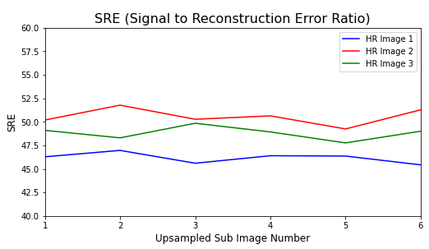
Q & Session
Evaluation Metric - SRE

Slide 19
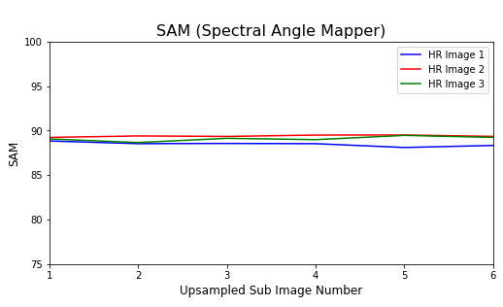
Q & Session
Evaluation Metric - SAM

Slide 20
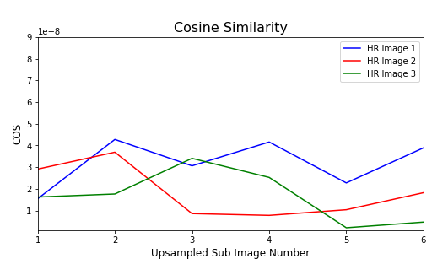
Q & Session
Evaluation Metric - COS

Slide 21
Conclusion
Major Deduction points from the Upsampling Model
Iterative Deprocessing
Epoch contrast
Deblurred PSNR
Iterative Cropping
Resolution Comparison between pre and post upsampling
Comprehensive Error Analysis
Considered Multiple Image Similarity Metrics
Graph Plotting
Notes:
Saw the impact of Deprocessing iteratively while extracting the deblurred images after every epoch of the training model. We saw the image comparison and
brightness/resolution after every epoch and the difference in PSNR during the deblurring process.
Saw the upsampling in each iterative crop of the SRCNN output image and noticed the difference in the resolution pre and post upsampling.
Built a comprehensive image similarity comparison using a host of metrics and their library implementations to see a vivid comparison across the metrics.
Plotted graphs to give a better graphical understanding of the upsampling behaviour in our model.

Slide 22
Q & Session
Q & A
Session
Notes:
We are now open to questions from the students as well as the faculty and instructors
Why did we choose Bicubic and not any other upsampling technique?
Nearest Neighbour - Fills the missing pixels up with whatever original pixel is the nearest to it, so it kinda looks like a step function - pixelated. Our images are of real life scenarios and hence we want the boundaries smoother
Bilinear - While Bilinear makes a linear relationship between original pixels to get the missing pixels, it becomes bad when the scaling factor is more than 3.
This will make it not a good choice when we decrease the crop size to say 80x80 and get 24 crops or even say 40 x 40 and get 96 crops - In those cases to resize back to Original Image size we’ll need to use very big scaling factors
Bilinear is also not good with steep contrasts as seen in many images in BSDS500 vivid colour images as then it would lead to steep lines and hence bad upscaling
Bicubic - This can help do complex shapes and hence have better smoothness with very less pixelation
However there might be chances of overshooting and undershooting near boundaries of colour spaces say at 0 or 255
Does picking a particular crop size give the best results during the upsampling?
We see that picking a large crop size gives a better result in upsampling. Bicubic uses the weighted average of 16 neighbouring pixels to compute the pixel that needs to be zero stuffed. A bigger crop size will give more pixels and more
Data to compute giving a better approximation of the zero stuffing. The scale factor during the upsampling is lower in a bigger crop size giving a better and more accurate scalable image.
Question regarding change in the color space BGR to RGB and deprocessing part?
What other evaluation metrics can you think of?
Why is upsampling as a post processing step and not in the beginning or anywhere in between?
Why is bicubic upsampling done only square matrices?
What change have you actually made in the Model from before?
We modified the post processing phase on the model to upsample iterative crops of a particular image and apply image similarity metrics
Why this when recent Deep SR Methods are more powerful?
Since the advent of SR-CNN, a variety of CNN networks with deeper and denser network structure like have been like SRDenseNet (67 Conv 2 Deconv Layers), SR-ILLNN (15 Conv Layers 2 DeConv layers), SR-SLNN (7 Conv Layers 2 DeConv Layers) etc but they are much hard to implement, slow
Why these Kernel Sizes?
The Filter 2 Fixed to 1 x `1 as that makes comparison to Sparse Coding Method Easier
However Increasing the 2nd Filter helps in utilizing more neighborhood information in the mapping stage hence higher performance (9 - 3 - 5 < 9 - 5 -5 )
However Deployment Speed drastically decreases as the number of parameters increases. Low speed for marginal performance increase
9-1-5 - 8,032
9-3-5 - 24,416
9-5-5 - 57,184 respectively.
The complexity of 9-5-5 is almost twice of 9-3-5,
Why ony Y channel?
Our method is flexible to accept more channels without altering the learning mechanism and network design.
In particular, it can readily deal with three channels simultaneously by setting the input channels to c = 3.
However Performing on the Y channel leads to much better performance as it is the Luminance Channel
But also if we use Y pre-train we get much better performance than the original method as described in the channel
first, to guarantee the performance on the Y channel, we only use the MSE of the Y channel as the loss to pre-train the network.
Then we employ the MSE of all channels to fine-tune the parameters

